Slide 1
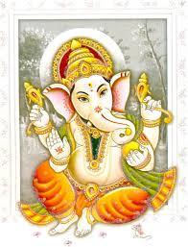
Good morning

Slide 2
Recall
Bias-Variance tradeoff
Misclassification
Over-fitting
Accuracy/Capacity

Slide 3
SVM Linearly separable
Margin
Maximal margin
Soft margin
Outliers
Hyper-plane
Structural Risk Minimization
Kernel-Polynomial, Radial(Rbasis)
VC Dim

Slide 4
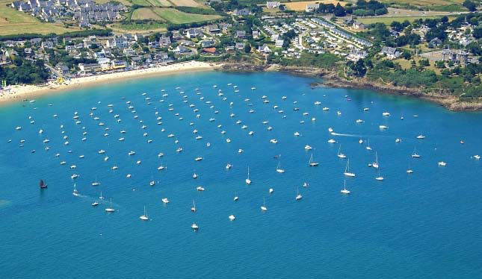
SVM-Linearly separable Some real life classification problems
Classify boats from houses

Slide 5
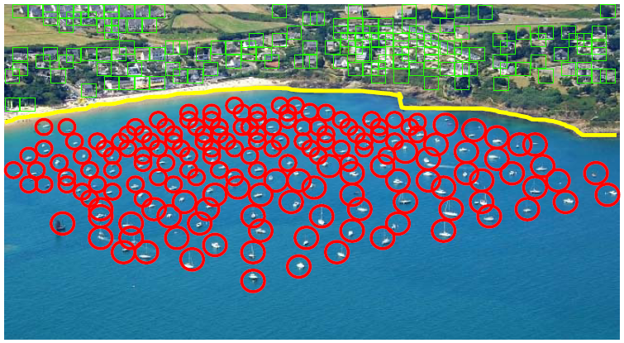
SVM-Linearly separable Some real life classification problems
All objects before the coast line are boats and all objects after the coast line are houses.
Coast line serves as a decision surface that separates two classes.

Slide 6
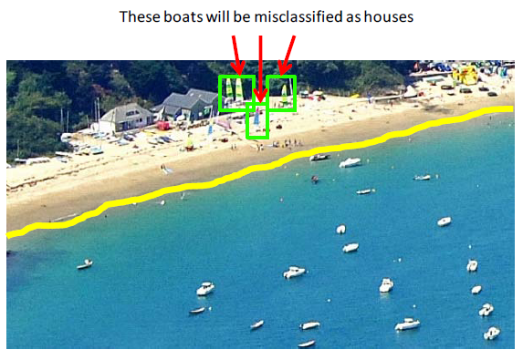
SVM-Linearly separable Some real life classification problems
What if some boats are in shore?.

Slide 7
SVM-Linearly separable Some real life classification problems
SVM’s offer solution to binary classifications which are complex.
SVMs are important because of
(a) theoretical reasons:
Robust to very large number of variables and small samples
Can learn both simple and highly complex classification models
Employ sophisticated mathematical principles to avoid over-fitting.
(b) superior empirical results

Slide 8
Good morning

Slide 9
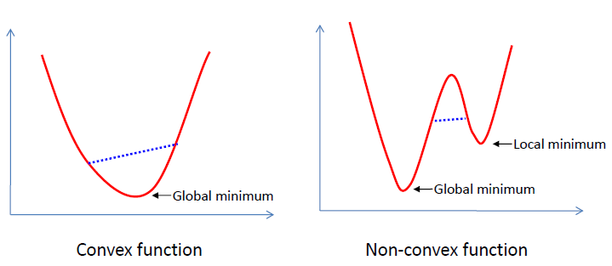
SVM-Linearly separable Mathematical concepts-Optimization
A function is called convex if the function lies below the straight line segment connecting two points, for any two points in the interval.

Slide 10
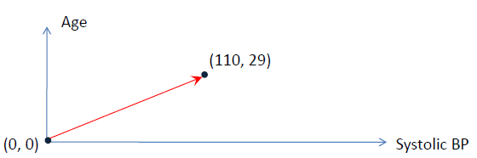
SVM-Linearly separable Mathematical concepts
Vectors.
Consider a patient described by 2 features:
Systolic BP= 110 and Age= 29.
This patient can be represented as a vector in R².

Slide 11
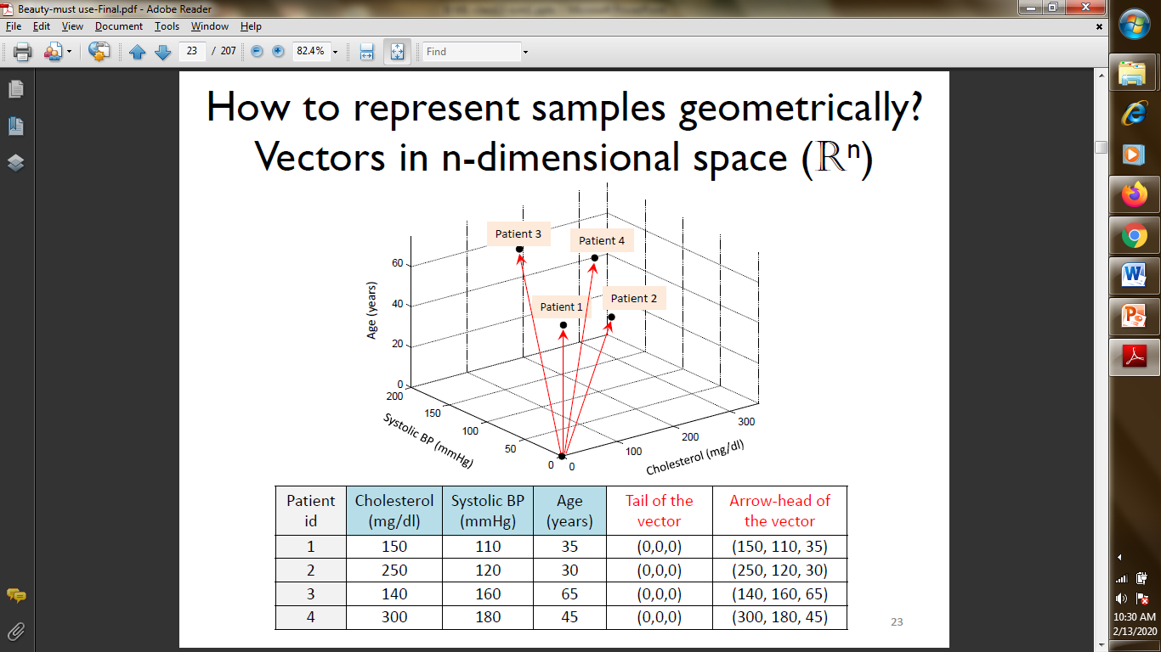
SVM-Linearly separable Mathematical concepts
Vectors. Representations in higher dimensions

Slide 12
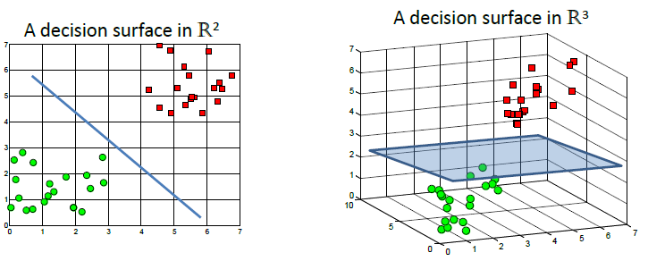
SVM-Linearly separable Mathematical concepts
Vectors. Representations in higher dimensions facilitates obtaining decision boundaries.

Slide 13
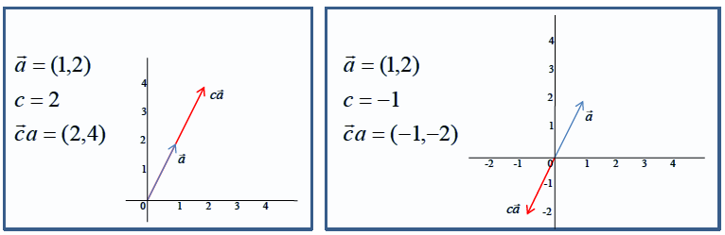
SVM-Linearly separable Mathematical concepts
Vectors. Multiplying a vector by a scalar.

Slide 14
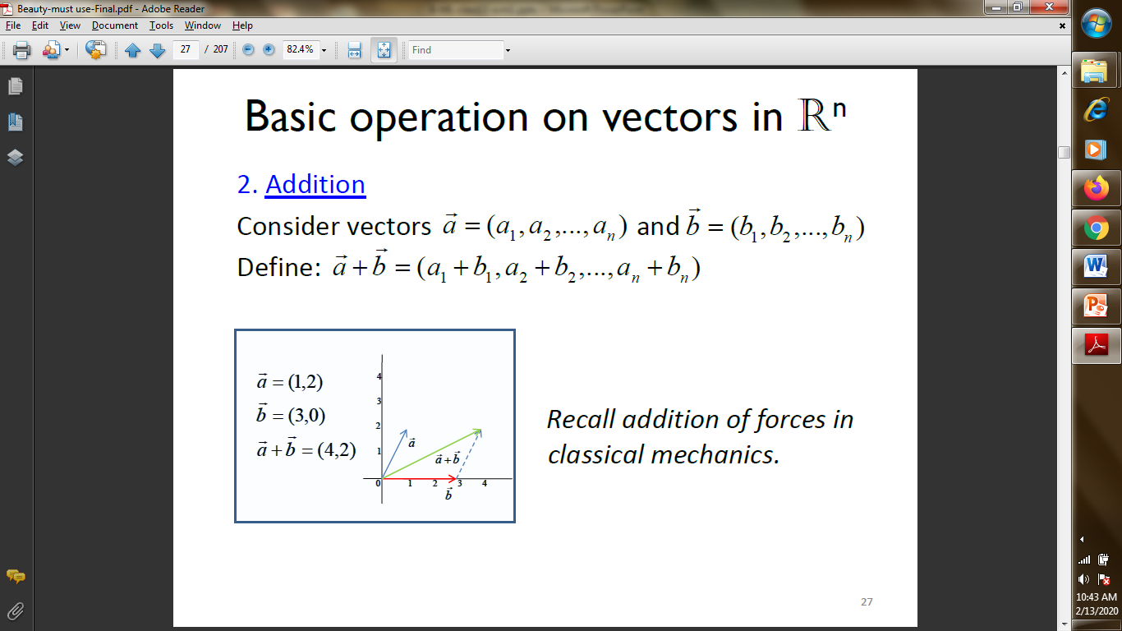
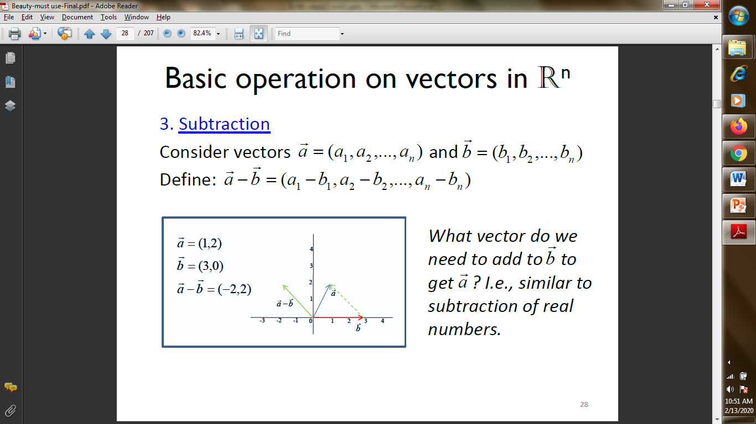
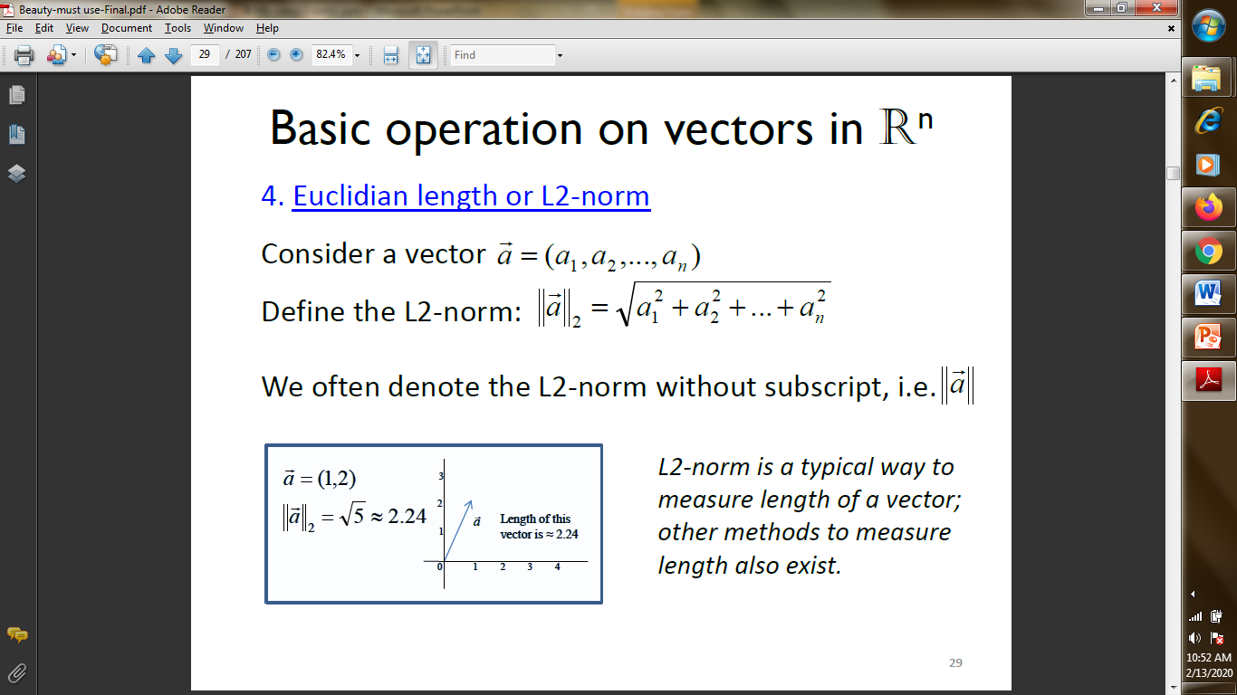
SVM-Linearly separable Mathematical concepts
Vectors. Vector length , addition, subtraction.

Slide 15
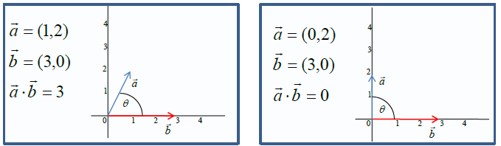
SVM-Linearly separable Mathematical concepts
Vectors. Dot product.
When a and b are perpendicular a . b=0.
In regression, y is just a dot product of the vector representing patient characteristics (x ) and the regression weights vector (w) which is common across all patients plus an offset b ,

Slide 16
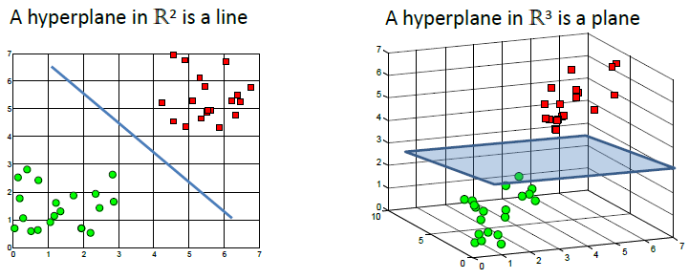
SVM-Linearly separable Mathematical concepts-Hyperplanes
A hyperplane is a linear decision surface(binary classifier) that splits the space into two parts.

Slide 17
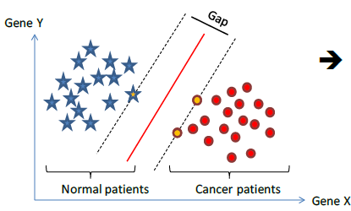
SVM-Linearly separable
So, if we know
How to represent patients (as “vectors”)
How to define a linear decision surface (“hyperplane”)
We can find
How to efficiently compute the hyperplane that separates two classes with the largest “gap”? Using the SVM

Slide 18
Good morning

Slide 19
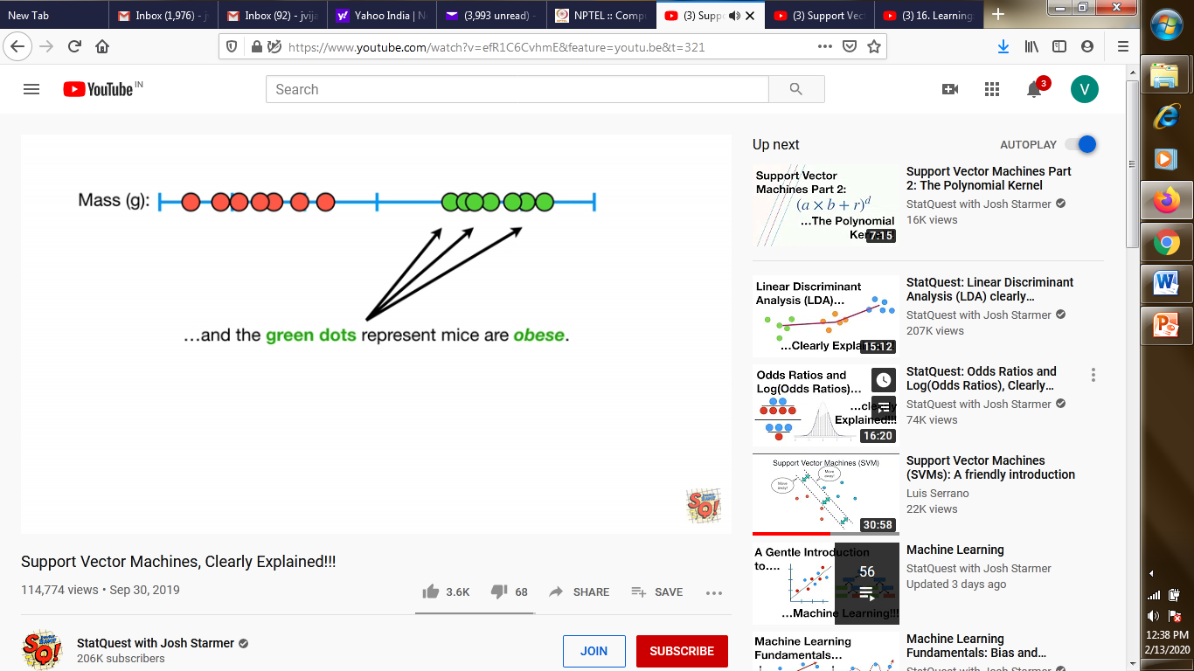
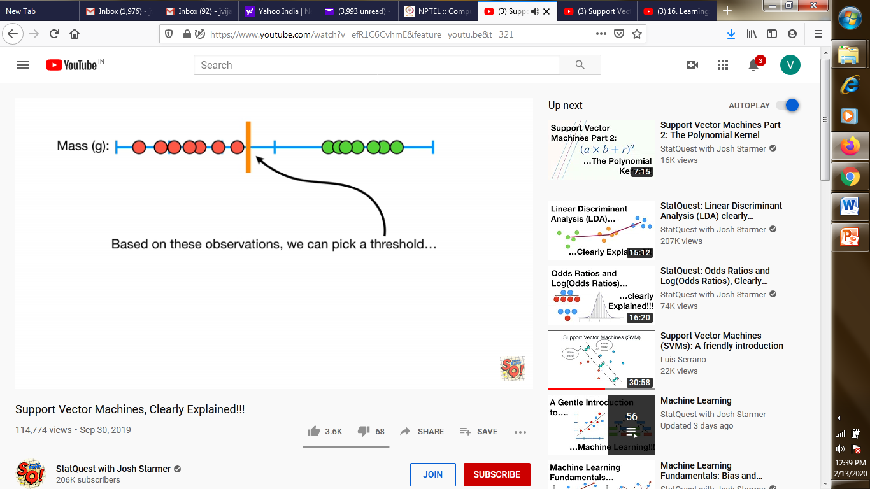
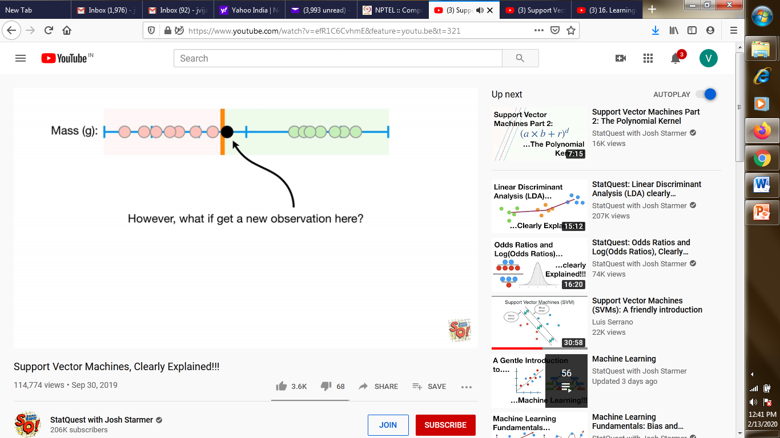
SVM
Recall simple binary classification problems, with a nice data
Where will we draw the classifier? Suppose
What are the possible practical issues

Slide 20
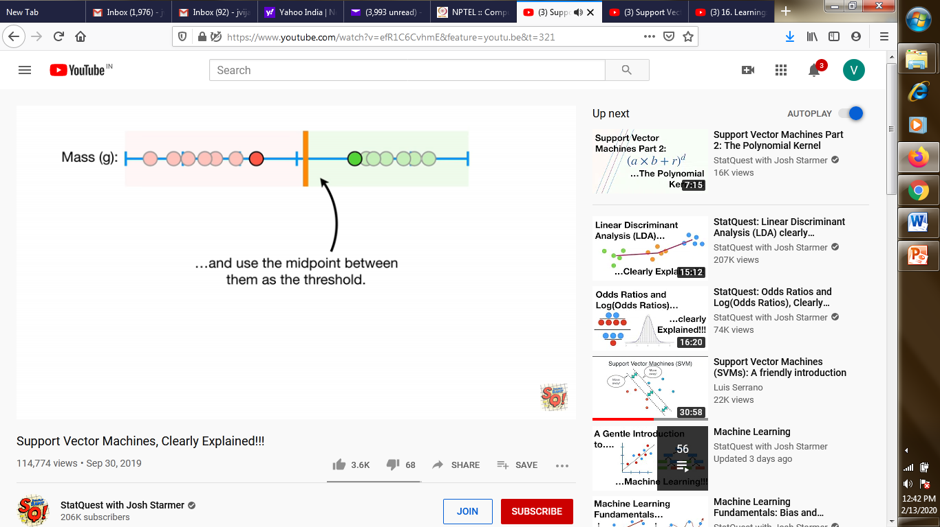
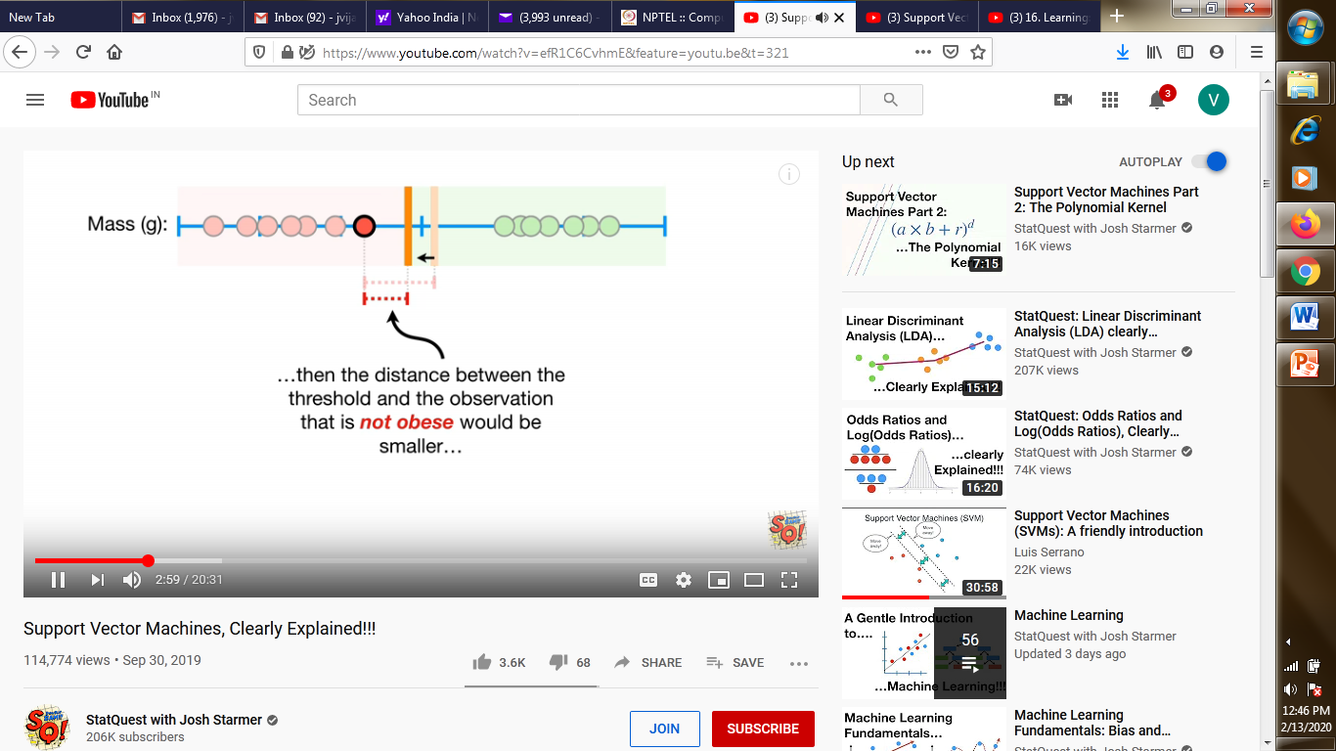
SVM
If we change the threshold
Works well.
We can actually use the margin for getting thresholds of varying distances from the borders but the margin is the smaller of the two distances and hence is smaller than midpoint placed threshold

Slide 21

SVM
When the threshold is the median of the distance between the extreme vectors, then we have the largest MARGIN.
This is called the Maximal Margin Classifier.

Slide 22
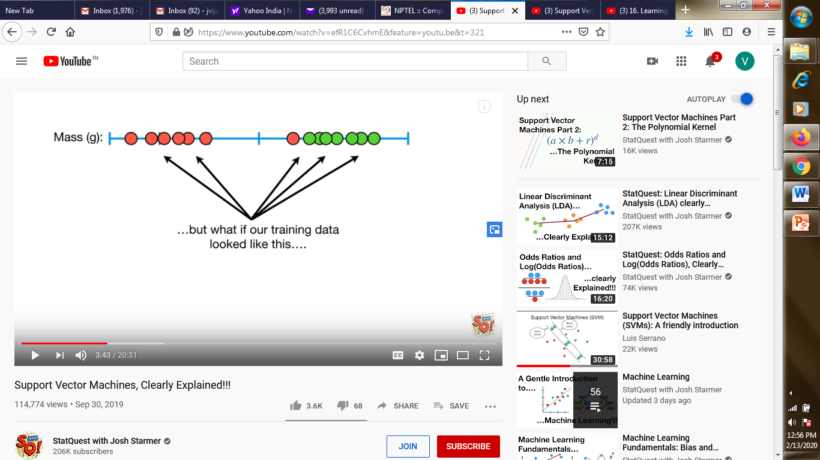
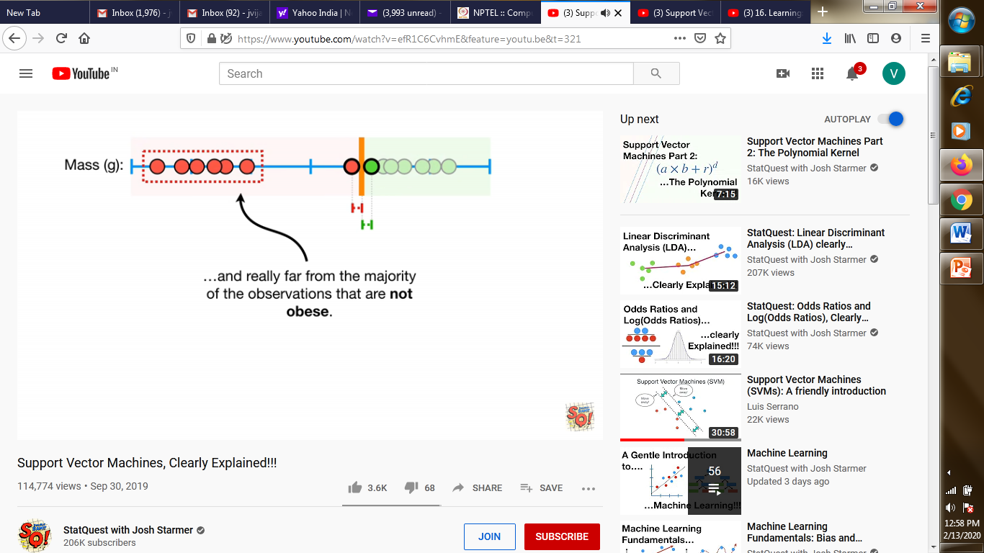
SVM
So, it seems logical to have the MMC as the best choice. What is our data is
If we go for MMC line , then
Which indicates the sensitivity of the MMC to outliers.
So, it clearly indicates that this is where we get into Bias-Variance kind of tradeoff.
Only thing is here outlier/misclassification and accuracy tradeoff

Slide 23
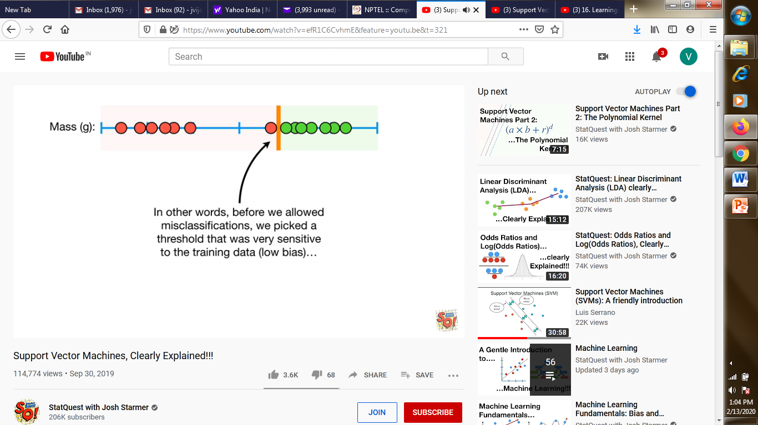

SVM
So, we allow misclassifications to improve accuracy.
Before allowing misclassification
After allowing misclassification
Improves performance

Slide 24

SVM
When we allow misclassification, the distance between the border vectors and the threshold is called Soft Margin
But now comes another question. How soft can we be? That is how many misclassifications can we /should we allow.
The answer is “cross validation”.

Slide 25
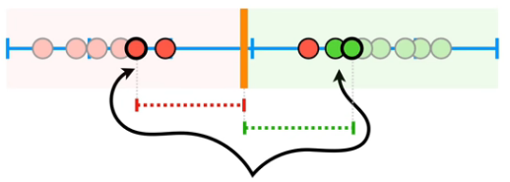
SVM
When we are using Soft Margin to determine the threshold of a classifier, we are getting Soft Margin Classifier or Support Vector Classifier.
The observations at the end are called the support vectors.

Slide 26
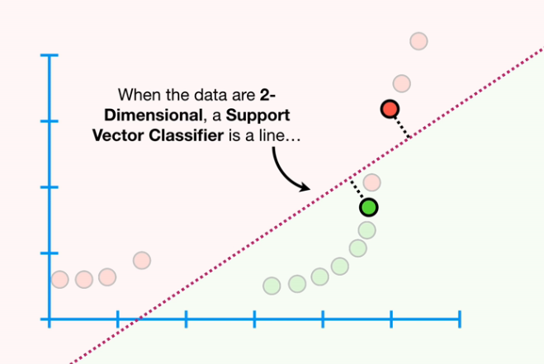
SVM
Now recall Hyperplanes.
When the data is one dimensional, support vectors are points.
When the data is 2-dimnl, the support vectors are lines,

Slide 27
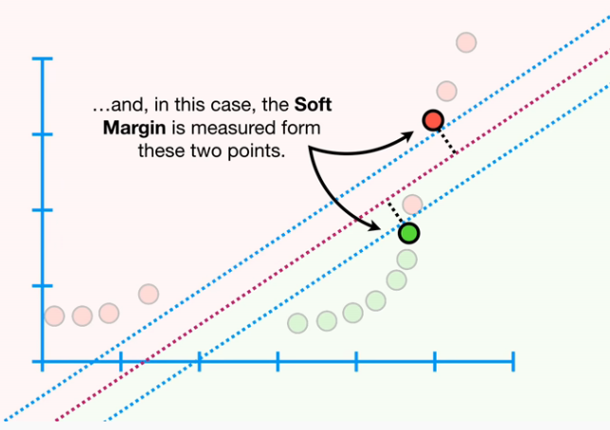
SVM
And soft margins are from
Blue lines are the indicators of cross validation. All points outside them are correctly classified and all within them are the outliers
This is what is called a street.

Slide 28
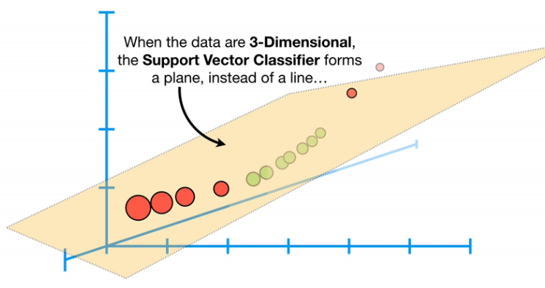
SVM
If data is three dimensional, then classifier is a plane
What if the data is 4-dimnl, 5-dimnl…? .

Slide 29
Good morning

Slide 30
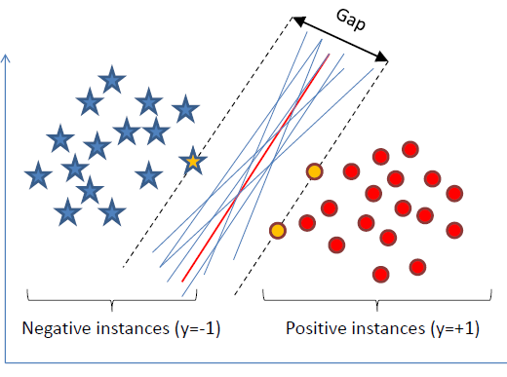
SVM-Linearly separable
Want to find a classifier (hyperplane) to separate negative instances from the positive ones.
An infinite number of such hyperplanes exist
SVMs finds the hyperplane that maximizes the gap between data points on the boundaries (so-called “support vectors”).
If the points on the boundaries
are not informative
(e.g., due to noise),
SVMs will not do well.

Slide 31
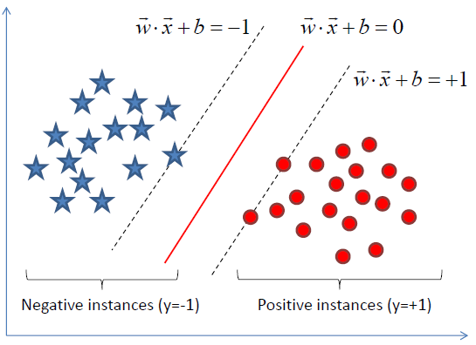
SVM-Linearly separable
The gap is distance between parallel hyperplanes:
We know that
Since we want to maximize the gap , we need to minimize
or equivalently minimize

Slide 32
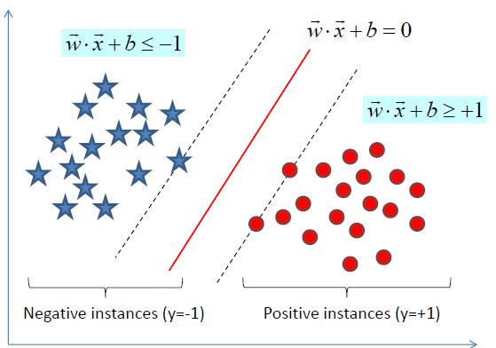
SVM-Linearly separable
The representation of the correct classifications are :
Want to minimize subject to for i= 1,…,N
Then given a new instance x, the classifier is

Slide 33
SVM-Linearly separable
Now we move into some real maths

Slide 34
Good morning

